Slide 1
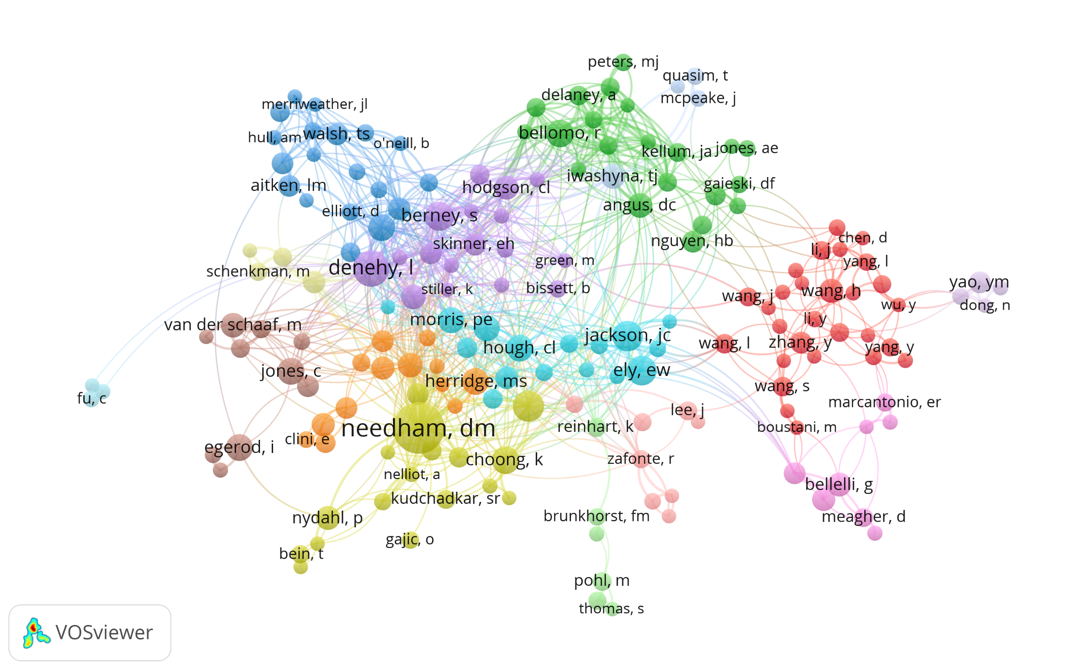
Early Mobility Author Network as of June, 2020
Based on PubMed Data

Slide 2
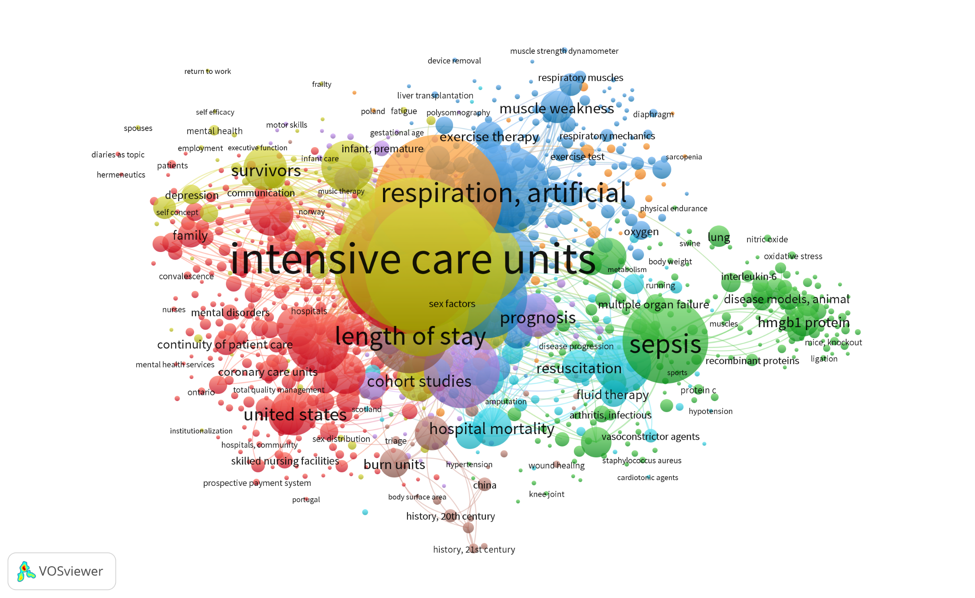
Early Mobility MeSH Network as of June, 2020
Based on PubMed Data

Slide 3
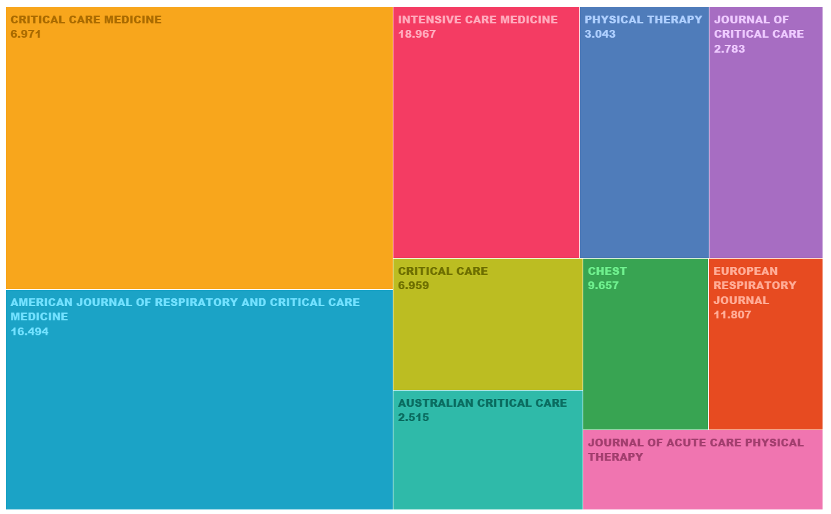
Early Mobility MeSH Network as of June, 2020 based on Web of Science Data

